Slide 1


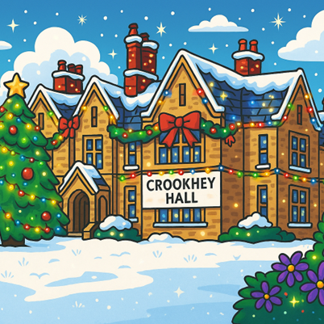
Autum Term Newsletter
2025

Slide 2

In this terms newsletter
In this terms newsletter:
A message from SLT
Our Term in Photos
World Mental Health Day
SMSC Events

Slide 3

A Message From The SLT Team
It has been a busy but exciting Autumn term here at Crookhey Hall School. We are incredibly proud of how well our pupils settled back into school life after the summer break. Their enthusiasm, resilience, and positive attitudes have been wonderful to see, and we are delighted with the strong start they have made.
We are also pleased to welcome our new students, who have settled in brilliantly. It has been lovely watching them build new friendships, learn routines, and become part of our school community.
This term has been packed with learning. Pupils have been working hard across all subjects, and it has been fantastic to see their confidence and skills grow. Our dedicated staff team continue to plan and deliver lessons that support every child to achieve their best.
We’ve also enjoyed a range of valuable SMSC (spiritual, moral, social, and cultural) opportunities. These experiences help pupils develop a deeper understanding of themselves and others while exploring the wider world around them. Moments like these are an important part of school life and help our pupils grow into kind, thoughtful, and respectful young people.
We would also like to share some exciting news about our leadership team. This term, we welcome Hannah Heys and Katie Roskell as our new Assistant Heads. They bring a wealth of experience and enthusiasm to their roles, and we are delighted to have them join the Senior Leadership Team. We know they will make a positive impact on our school community and support our ongoing work to help every child thrive.
As we reach the end of Autumn term, we look forward to the weeks ahead. With the changing season bringing cooler days and new opportunities, we have plenty of learning, activities, and experiences planned to keep our pupils engaged and inspired.
Thank you for your continued support. It truly makes a difference.

Slide 4

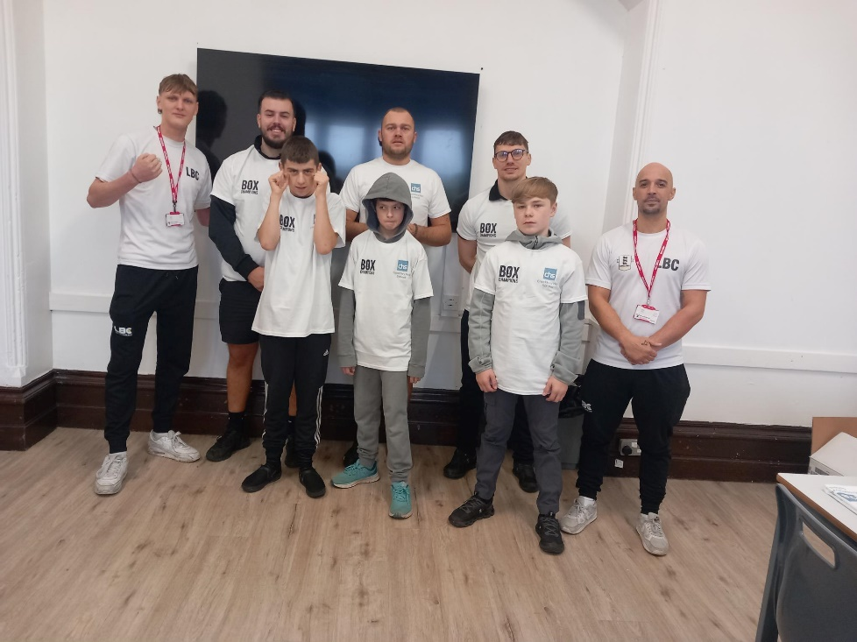
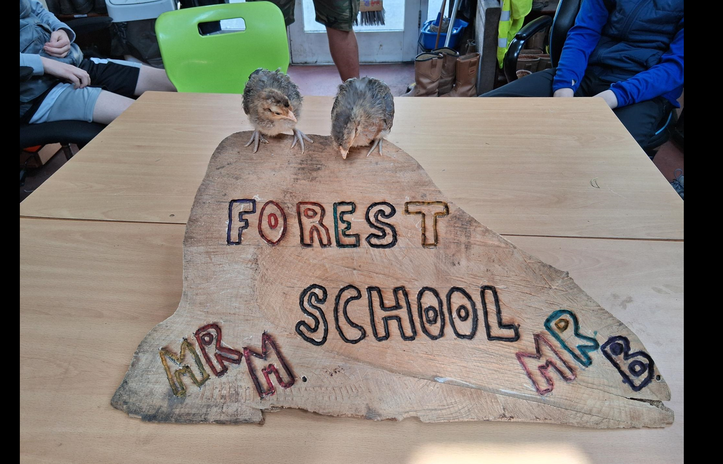
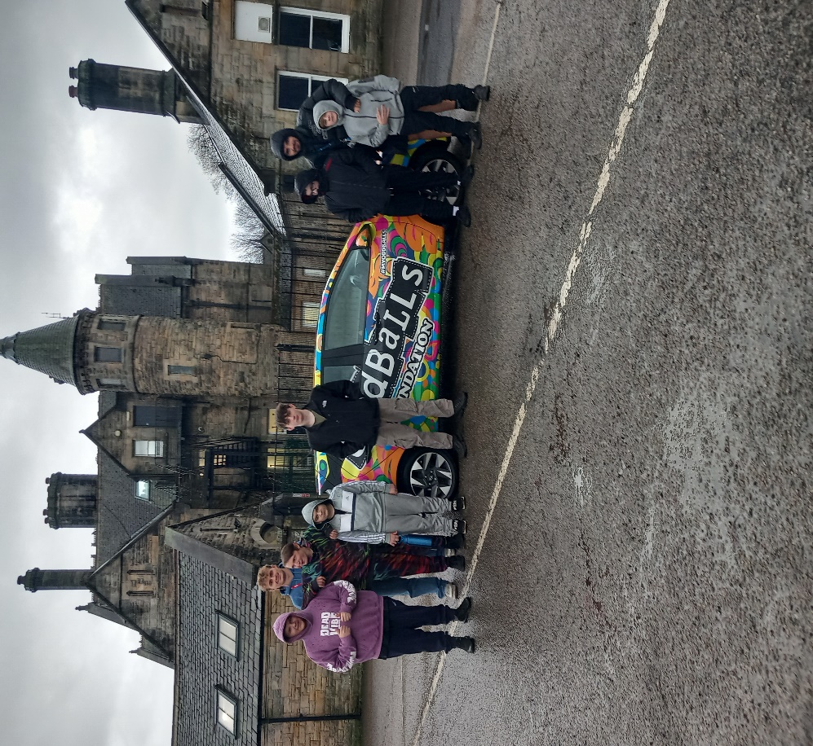
Our Term in Photos
This term our Outdoor Education groups work hard to complete their first six principles of boxing!
They have well and truly earned their awards!
We had a representative from The ‘Oddballs’ Charity come to visit us and present an assembly about how important it is to know your body and regularly check yourself.

Slide 5
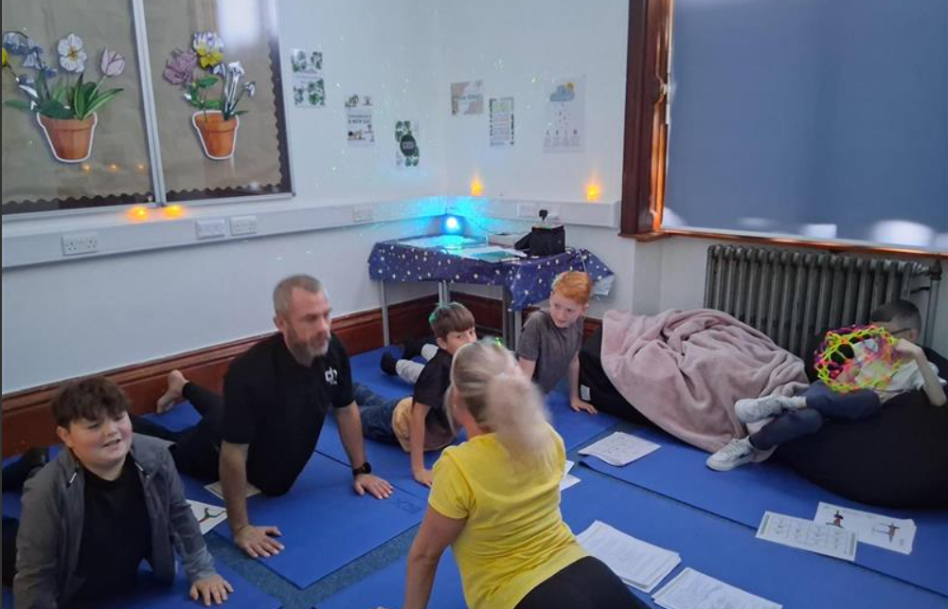
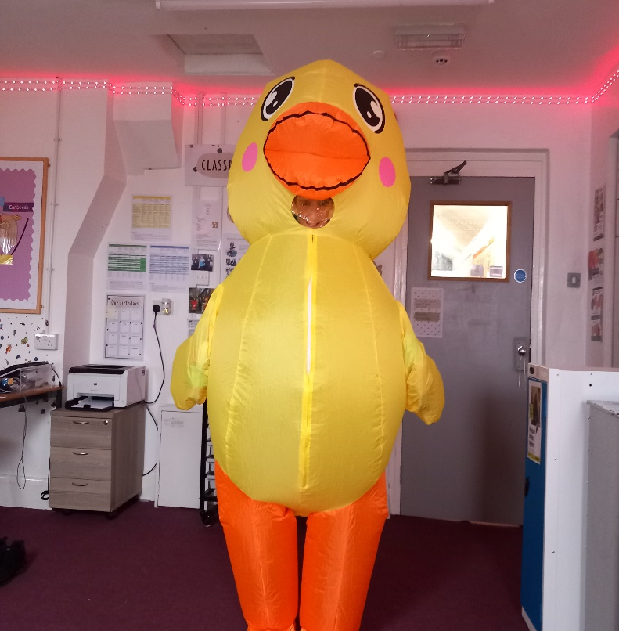
World Mental Health Day
We celebrated World Mental Health Week, it reminded everyone to prioritise wellbeing, seek support when needed, and look out for others.
Thank you Miss Bramwell for taking the lead.
We all followed this years theme and ‘wore something yellow’. It was important for students to take part as it helped them understand and manage their emotions, encouraged them to talk openly about how they feel, built empathy for others, promoted lifelong wellbeing habits, and supported a positive, caring school culture.
It was also a great day for self-expression.

Slide 6

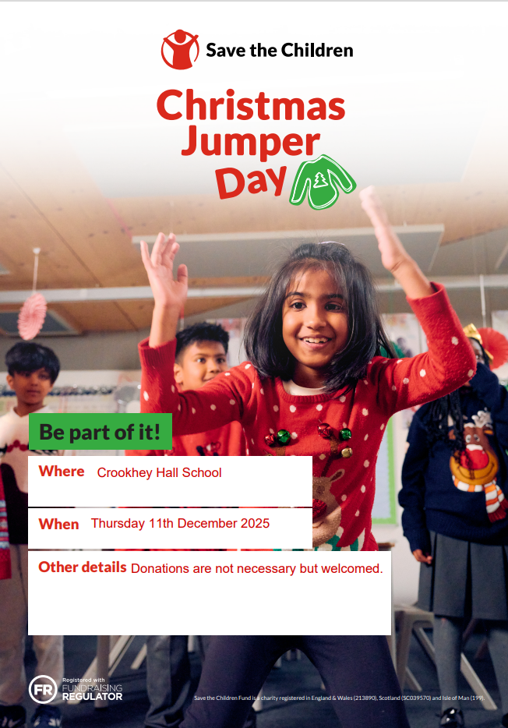
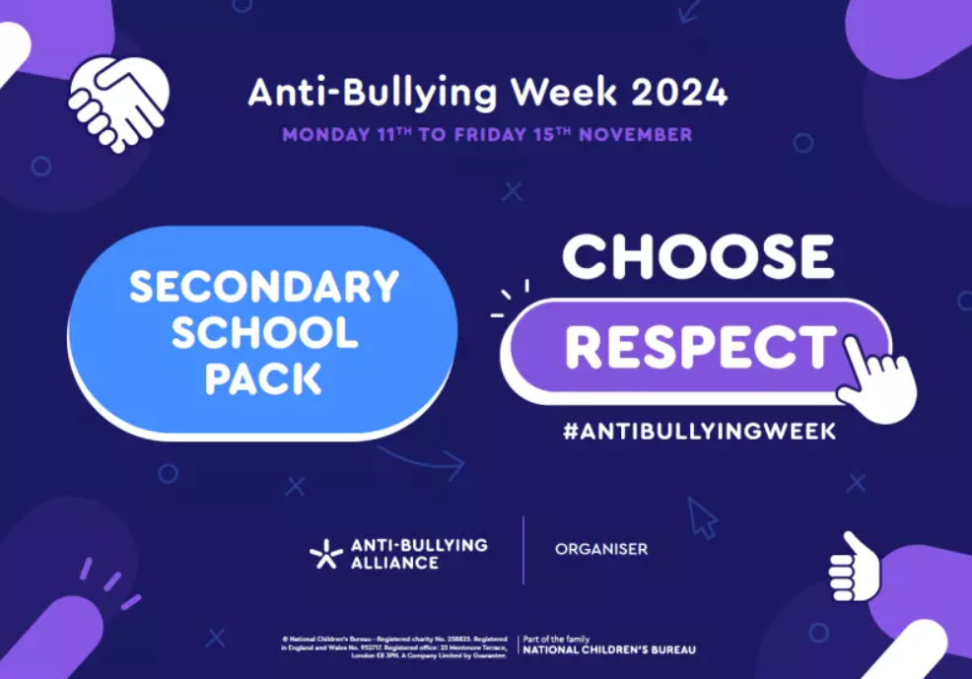
SMSC events
At Crookhey Hall, we believe our Social, Moral, Spiritual and Cultural (SMSC) journey is impactful as it helps pupils develop into well-rounded, thoughtful, and responsible individuals. It encourages them to understand themselves, respect others, make positive choices, appreciate different cultures and beliefs, and contribute to their community with kindness and confidence.
Our Themes this term:
Remembrance and Kindness
Celebration and Togetherness
Remembrance Day (Nov 11)
Anti-Bullying Week (Nov 11-15)
Inter Faith Week (Nov 24-29)
Christmas Jumper Day (Dec 11)
Christmas Lunch (Dec 15- 16)
Christmas Fair (Dec 18)

Slide 7


