Slide 1
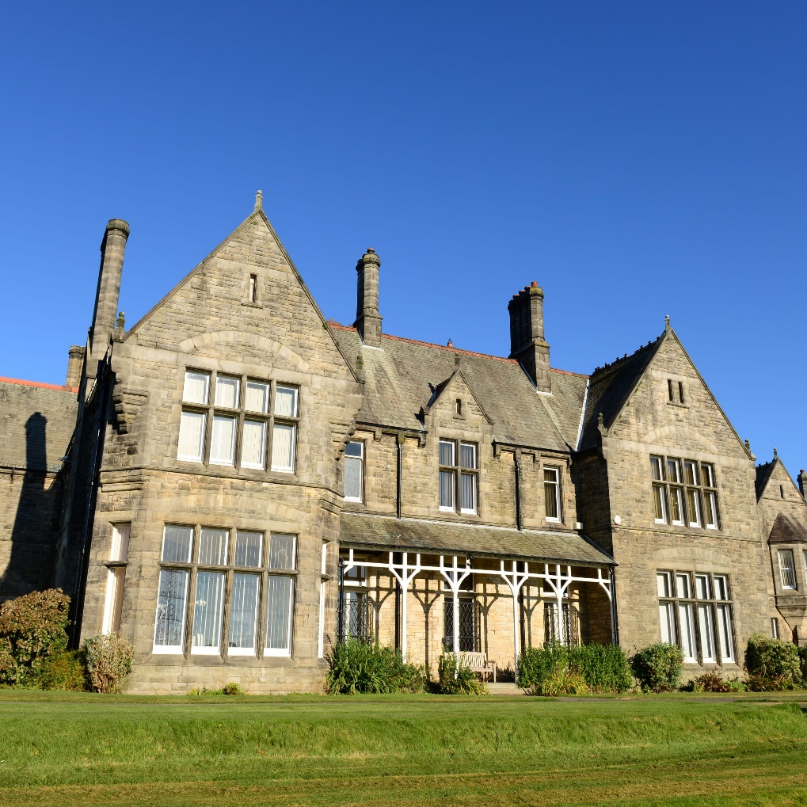
Spring Term Newsletter
2024 - 2025

Slide 2
In this terms newsletter
In this terms newsletter
A message from the Head
Small Animal care
Curriculum News
SMSC Events

Slide 3
A Message From The Headteacher
Jane Husbands
It has been a busy but exciting year so far at school. We’re proud of how far we’ve come together. The students have shown great resilience and enthusiasm in everything they’ve done, and we are very proud of them. It has been great to see our new students settling in so well.
We’ve completed lots of learning this year already. The pupils have worked hard in all their subjects, and it’s been wonderful to see their progress. Our staff have been working just as hard, planning lessons that help every child grow in confidence and knowledge.
We’ve also enjoyed some fantastic opportunities for SMSC (spiritual, moral, social, and cultural development). Pupils have taken part in a range of activities that help them learn about themselves, others, and the world around them. These moments are a big part of school life, helping our children to become kind, thoughtful and respectful individuals.
Our end of term trips have been a highlight for many. It’s always lovely to take learning beyond the classroom and see pupils enjoying new experiences. These trips are great for building friendships, making memories, and having fun in a safe and supportive way.
As we look ahead to the summer term, we are excited about what’s to come. This is a time of year we all look forward to. The weather (hopefully!) will be bright and warm, and we have more learning, trips, and celebrations planned.
Thank you for your continued support. It really does make a difference. Together, we can help every child reach their full potential and enjoy their time at school.

Slide 4
Small Animals
This term in small animals, we have expanded our menagerie with our new corn snake. Sydney is 9 years old and hasn't been handled regularly for the past couple of years so we are slowly getting her used to being in our classroom.
We have also had the first hatching of our Cream Legged Bar chicks. These are both females and will be handled regularly to make sure they are used to our young people.

Slide 5
SMSC events
Children's Mental Health Week
During form pupils where given work packs on strategies to support positive mental health. They watched videos provided by the charity. All pupils' homes received “healthy mind support” packs. Friday was “dress to express” where our pupils raised £280 through attending school in fancy dress to express themselves. All the money raised was Donated via just giving to Place2Be, a mental health charity.
International women’s day
The female pupils were taken on a small hike up Nicky Nook. When they reached the summit, they read books from female authors. They then went down in the woods where staff read “women in power” poetry pieces and spoke about women as role models before completing guided meditation.
Exploitation and grooming team
The exploitation team from the local support service attended school for a full day every Wednesday of Spring 2. They delivered sessions on exploitation and grooming to all pupils from year 9 to year 11.
World Religion Day
This was celebrated in a range of different ways. We held assemblies with two guest speakers. One from the local church and one from a local mosque. Our dinner menu for the week was based on five different religions and Topic lessons looked at religions.
Holocaust Memorial Day
Pupils explored Holocaust history in assemblies. Break time tuck was linked to Jewish culture. Weekly topic lesson was to create a class memorial for the Holocaust which was judged by SLT and winning class received caught your coupons.

Slide 6
Curriculum news
Science
Last half term a new reward system was introduced/trialled in Upper School Science lessons– Scientist of the week and most improved Scientist of the week. One pupil each week was chosen for each award where each pupil received a certificate and 3 Caught You coupons towards their end of half term reward. This has encouraged pupils to compete for the awards and winners have been announced in assemblies. Following the success of this incentive, this is going to be rolled out to lower school also.
In Lower School class 13 have been looking at Ecology and populations of species and been doing some random sampling of plants with quadrats collecting and analysing data to estimate populations on the school field.
Year 9 classes 6 and 7 have been developing their practical skills and working towards their Entry Level Certificate qualification paper 4 and have now completed their first Science assessment. They have been focussing this half term mainly on acids, alkalis and neutralisation and looking at the practical uses of these techniques and fun aspects e.g making sherbet and making their own indicator using red cabbage.

Slide 7
Curriculum News
Science continued
They are currently working towards completing and Entry Level Certificate paper towards their qualification.
Year 11 in classes 1 and 2 have mainly been focussing on exam practice in preparation for their GCSEs or working towards their Entry Level Certificate. Some pupils have managed to achieve their full potential this half term with 5 pupils achieving the maximum Entry Level Certificate 3 with their determination and persistence. Next half term the focus will be on reviewing the required practical activities for GCSE candidates which will be linked to the exam practice.
Pupils have used what they have learnt with the pH scale and neutralisation to create their own pH scale picture below.
Year 10 have been developing their practical skills and group work when looking at different salts and how to make them which links to their previous topic of Separating Mixtures. They have made salts and crystallised them. Below is a picture of a sample of crystals made by class 5 of Copper Chloride when they reacted Hydrochloric Acid with Copper Oxide. This also links to the acids and alkali topic they have been studying as it demonstrated complete neutralisation.

Slide 8
Curriculum news
Science Key Dates
Key dates for GCSE exams:
Biology Paper 1 (Cell Biology, Organisation, Infection and Response, Bio-Energetics): Tuesday 13th May 2025 PM
Biology Paper 2 (Homeostasis and Response, Inheritance, Variation and Evolution, Ecology): Monday 9th June 2025 AM

Slide 9
Curriculum News
Class 3’s Spring Term
Class 3 recently visited Heysham Nuclear Power Station as part of their Entry Level Certificate in Science studies. The visit provided an exciting and educational insight into nuclear energy. Students explored a gas-cooled reactor gallery, turbine hall, and the control room viewing gallery, gaining a real-world understanding of how electricity is generated.
A highlight of the trip was watching fuel rod maintenance in action, which gave students a rare opportunity to see behind the scenes of a working power station. The experience helped bring their science curriculum to life in a memorable and inspiring way.

Slide 10
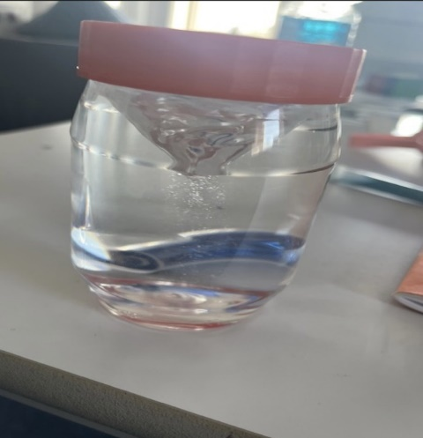
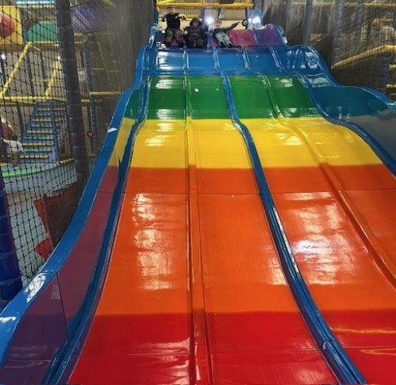
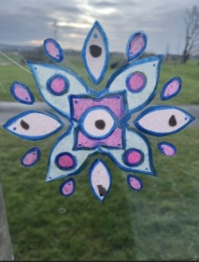
Lastly the pupils excelled in their outdoor education sessions, especially their boxing lessons. Some of the pupils were a little unsure of this activity to start, but week by week their dedication and perseverance paid off and every pupil made excellent progress with their boxing skills.
The pupils of class 12 have experienced lots of hands-on practical learning throughout Spring term. Whether this was making Rangoli patterns and mini tornadoes in our Humanities lessons or mini habitats and eco systems in our science lessons. The pupils have really enjoyed being more creative with their learning.
We have also had the opportunities for lots of class trips out as part of our life skills sessions. The pupils always enjoy these sessions and the opportunity to get out into the community. They always represent the school well and have enjoyed ticking off their life skills passports, whether this is visits to the local farm, playing together or visiting places of interest in the local area.
Curriculum news
Class 12’s term news

Slide 11
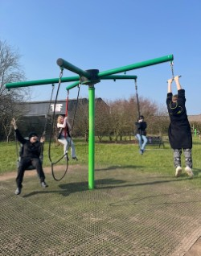
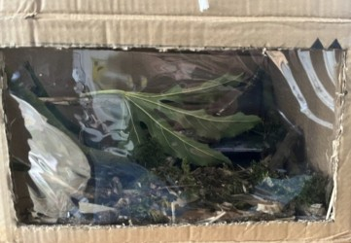
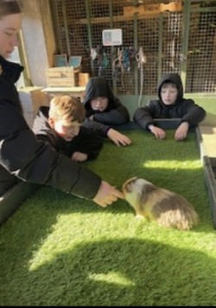
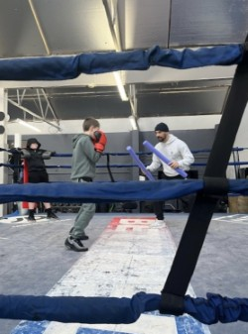
Class 12’S Term news cont..

